Slide 1

BREAST CANCER​ PREDICTION
USING MACHINE LEARNING ALGORITHMS
CREATED BY: KAMAL THAPA

Slide 2

What is Breast Cancer?
Breast cancer is a type of cancer that begins in the cells of the breast.
It can occur in both men and women, but it is far more common in women.
Breast cancer is characterized by the uncontrolled growth of abnormal cells in the breast tissue.

Slide 3

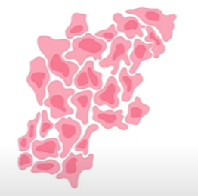
Types of Tumor
Benign Tumor
Non-Cancerous
Capsulated
Non-invasive
Slow growing
Do not metastasize
Cells are normal.
Malignant Tumor
Cancerous
Non-Capsulated
Fast Growing
Metastasize
Cells have large,
dark nuclei; may have abnormal shape.

Slide 4
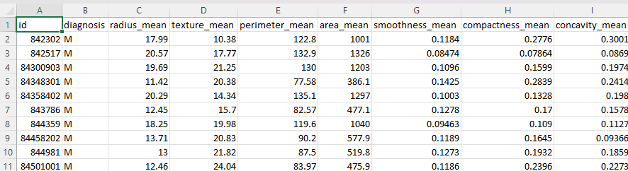
Dataset
Fine Needle Aspiration is a type of biopsy procedure. In fine needle aspiration, a thin needle is inserted into an area of abnormal-appearing tissue or body fluid. As with other types of biopsy's, the sample collected during the fine needle aspiration can help make a diagnosis or rule out conditions such as cancer.

Slide 5


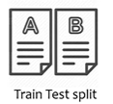


Work Flow
Random Forest Classifier Model
Benign
OR
Malignant
New Data
Trained Model
Prediction

Slide 6
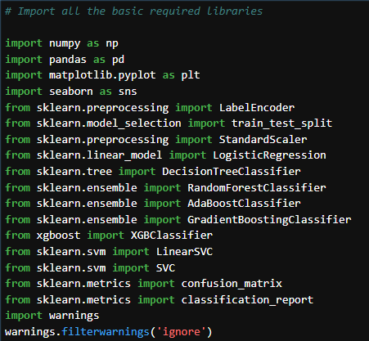
Import all the basic required Libraries

Slide 7
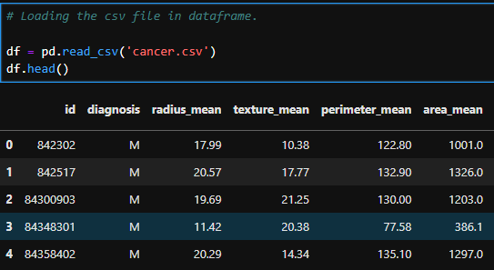
Import the csv file
Imported the csv file with Top 5 rows.

Slide 8
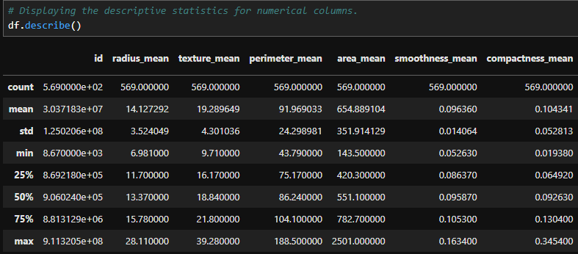
Descriptive Statistics for Numerical columns.

Slide 9
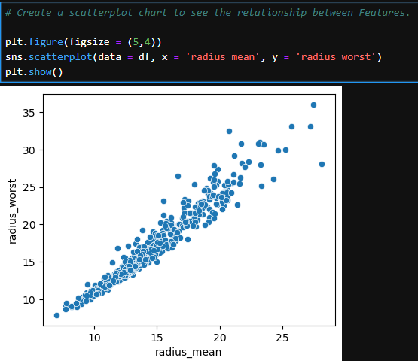
Features(Inputs) Relationship using Scatterplot

Slide 10
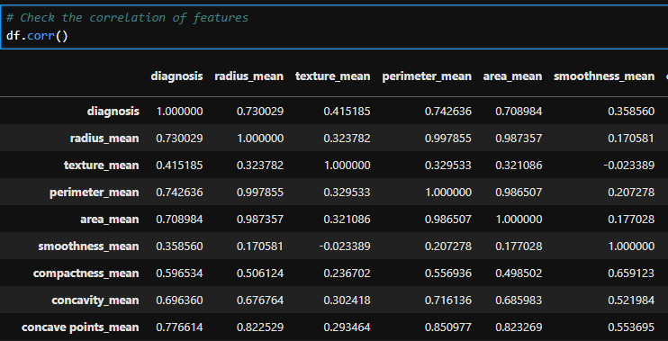
Features Correlation

Slide 11
Model Training Random Forest Classifier
A Random Forest Classifier is a type of machine learning model that combines multiple decision trees to improve accuracy and prevent overfitting.
Advantages
Reduced Overfitting: By averaging multiple trees, the model generalizes better and is less prone to overfitting compared to a single decision tree.
Handles Large Datasets: Efficient with large datasets and high-dimensional data.
Feature Importance: Provides insights into feature importance, helping identify which features contribute most to the prediction.
Robustness: Less sensitive to noisy data and outliers compared to individual decision trees.

Slide 12
Random Forest Classifier
Disadvantages
Complexity: Can be more complex and computationally intensive than individual decision trees.
Interpretability: The ensemble of many trees makes it harder to interpret compared to a single decision tree.

Slide 13
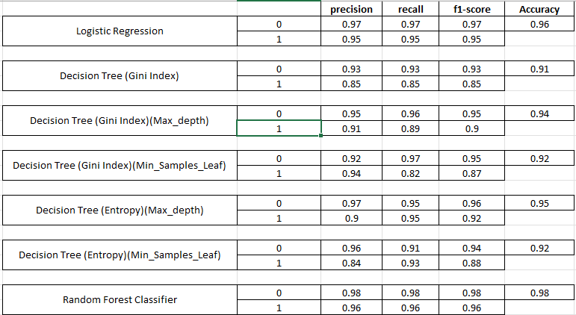
All Models Scores. - 1

Slide 14
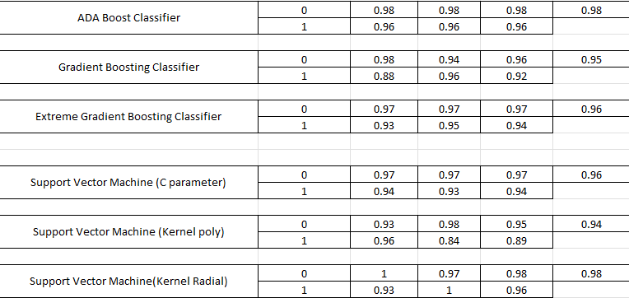
All Accuracy Scores. - 2

Slide 15
Conclusion
We tested various models to predict the outcome, aiming for the highest accuracy score. Among them, Random Forest yielded the best results, measured by accuracy, precision, recall, and F1-scores.
Random Forest Classifier: 98% accuracy
We consider the Random Forest Classifier is the more reliable model, given its high accuracy compared to the other models tested.

Slide 16
Question & Answer (Q&A)
Thank you for your time. Now, we welcome to the Question & Answer Session.

